Slide 1
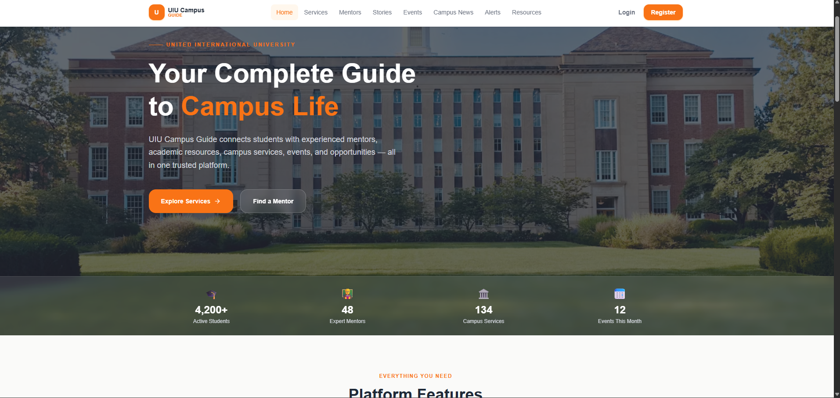
CAMPUS GUIDE
One Platform for Campus Life, Careers and Mentoring
Team Syntax Squad
UIU Department of CSE
Faculty teacher Rejwan Ahmed
September 2026
Notes:
We are Team Syntex Squad from the UIU Department of CSE. Campus Guide brings campus information, career guidance and mentoring into one verified platform. We present this project under faculty teacher Rejwan Ahmed.

Slide 2





STUDENT LIFE AT UIU IS SCATTERED
Students search across channels. Trust stays uncertain.
Scattered notices
Generic advice
Hidden mentors
Unprotected payments
Boards and Facebook groups
No personal career path
Word-of-mouth discovery
bKash tutoring transfers
Notes:
Campus notices are spread across physical boards and Facebook groups. Career advice is often generic, mentors are found through word of mouth, and tutoring payments through bKash lack a protective session-confirmation flow.

Slide 3





FIVE COMMITMENTS ANSWER THE PROBLEM
Centralize campus information
Personalize career guidance
Connect verified mentors
Protect payments with bKash escrow
Build trust through verification, ratings and oversight
One platform.
Trust built in.
Notes:
These five commitments directly answer the four gaps. Centralized information reduces searching. Personalized guidance makes advice actionable. Verified mentors make help discoverable. Escrow protects the payment flow, while ratings and administrative oversight support trust across the platform.

Slide 4



THREE PILLARS, ONE VERIFIED LOGIN
Campus Info Hub
Career Path Finder
Mentor-Powered Help
Campus information in one place
Guidance shaped by a profile
Verified people, bookable services
All behind @uiu.ac.bd email verification
Notes:
The platform has three pillars, but students do not need three separate identities. Campus Info Hub, Career Path Finder and Mentor-Powered Help sit behind the same UIU email verification boundary.

Slide 5
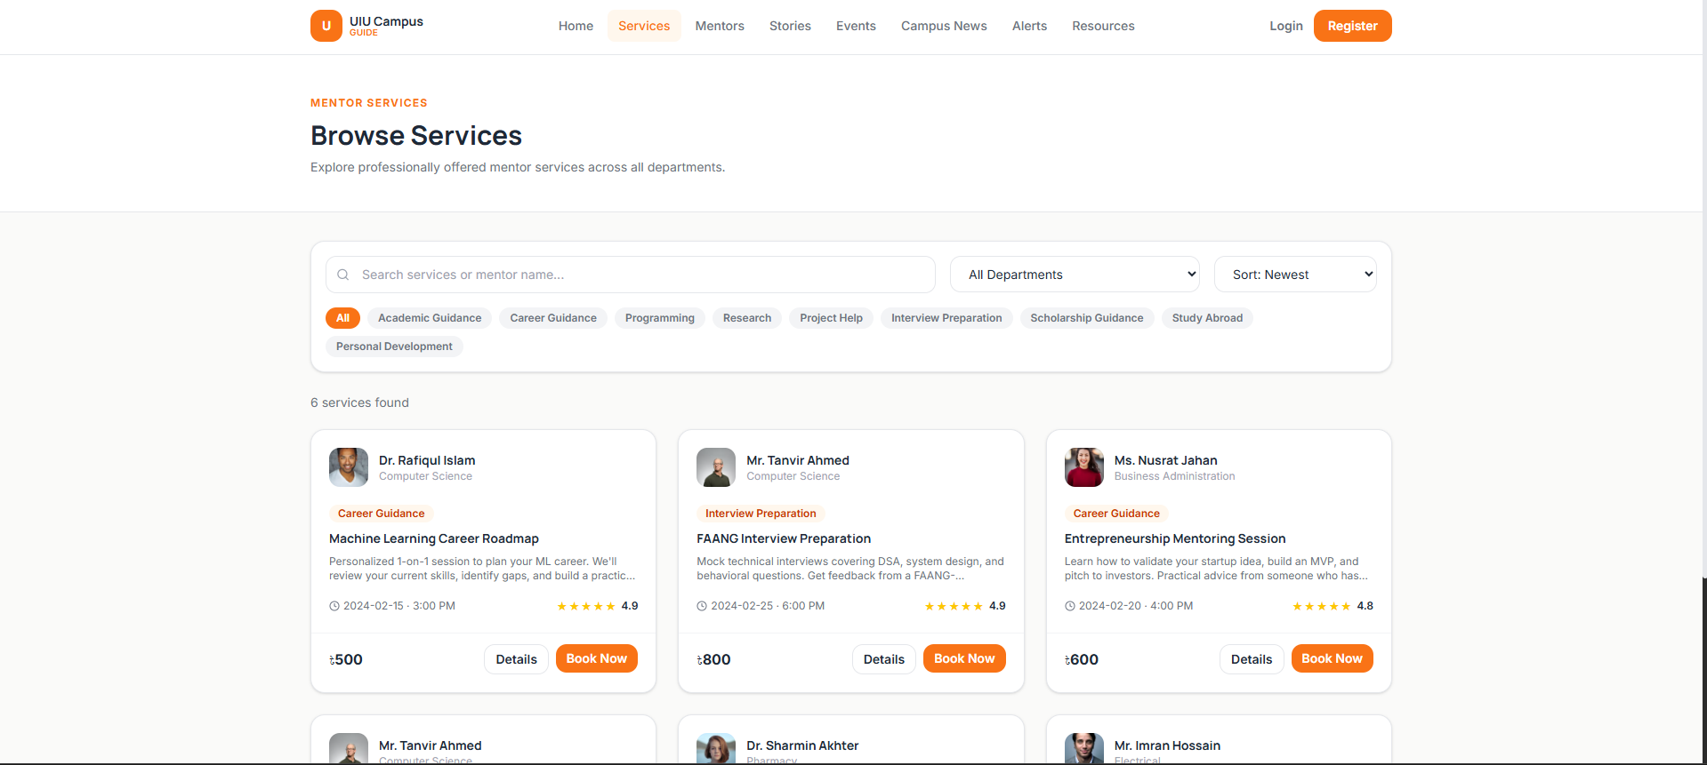
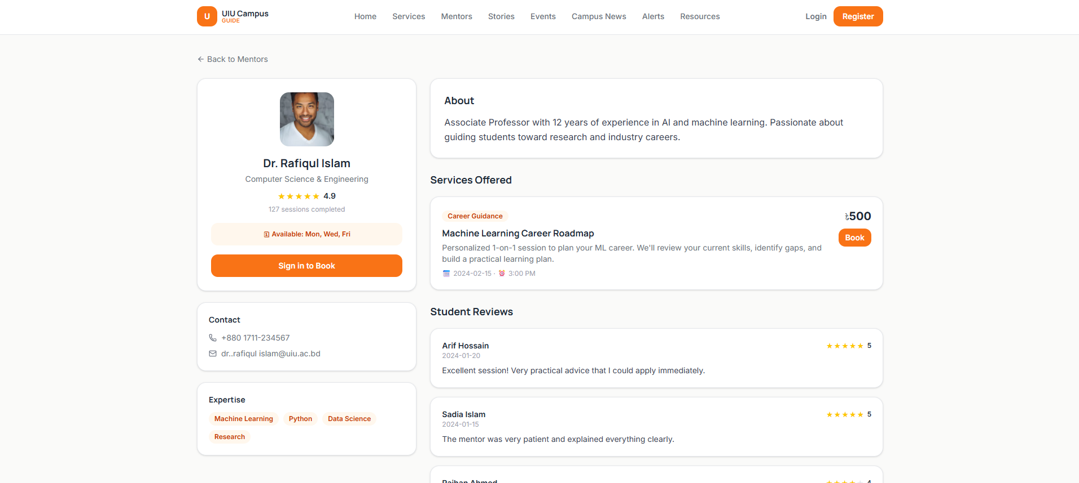
FIND A MENTOR IN MINUTES
01
Browse services
Category and department
02
Compare mentors
Ratings and prices visible
Machine Learning Career Roadmap
Dr. Rafiqul Islam · 4.9 stars
Notes:
Students browse by category and department rather than asking around. Ratings and prices are visible during discovery. The example is the Machine Learning Career Roadmap by Dr. Rafiqul Islam, rated 4.9 stars. The title describes the intended discovery experience, not a measured timing result.

Slide 6
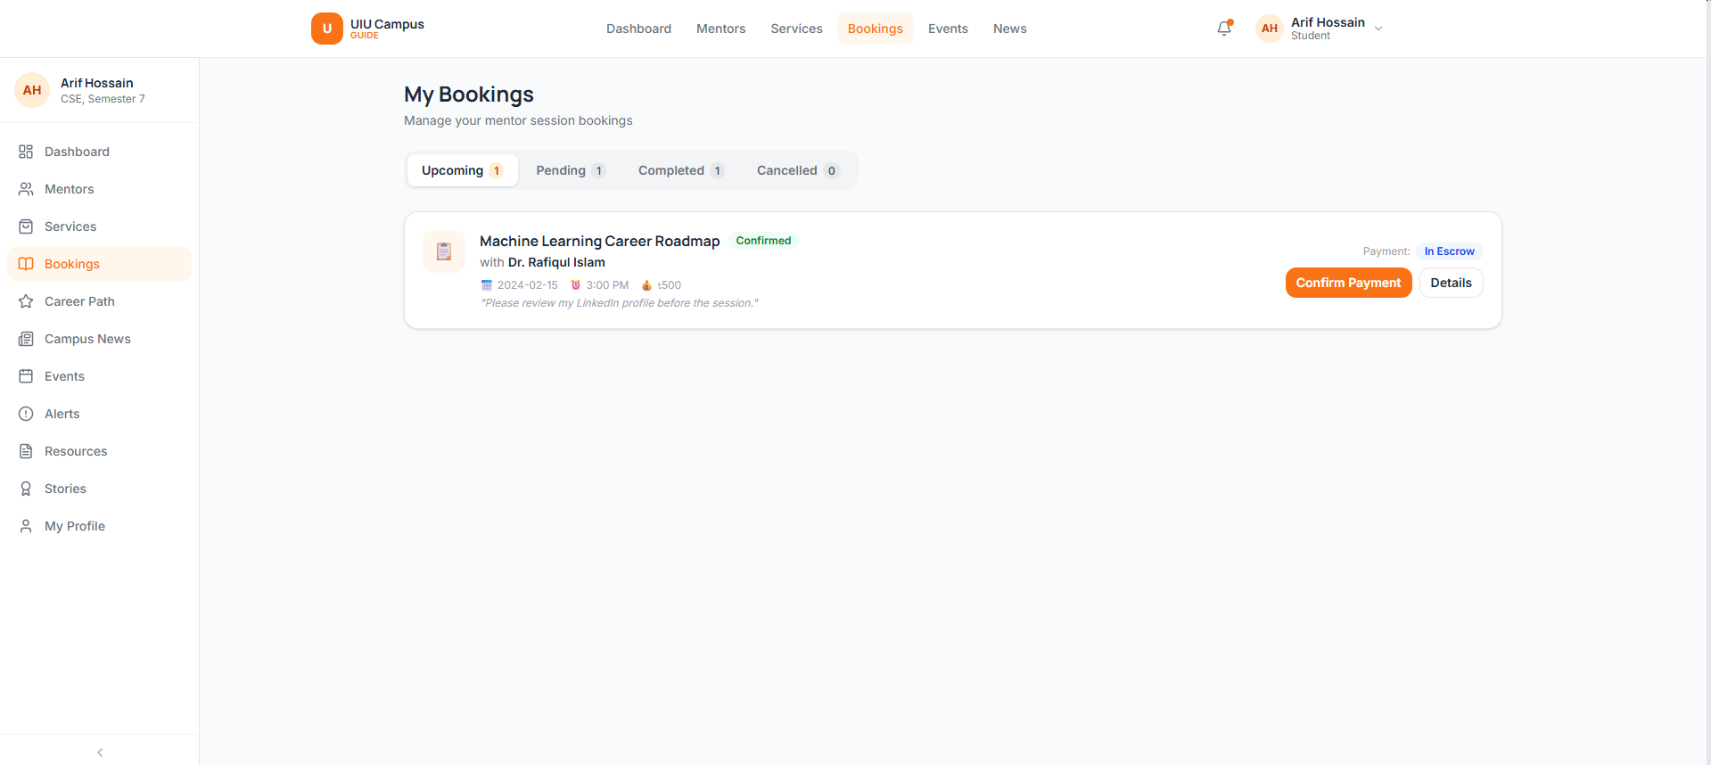
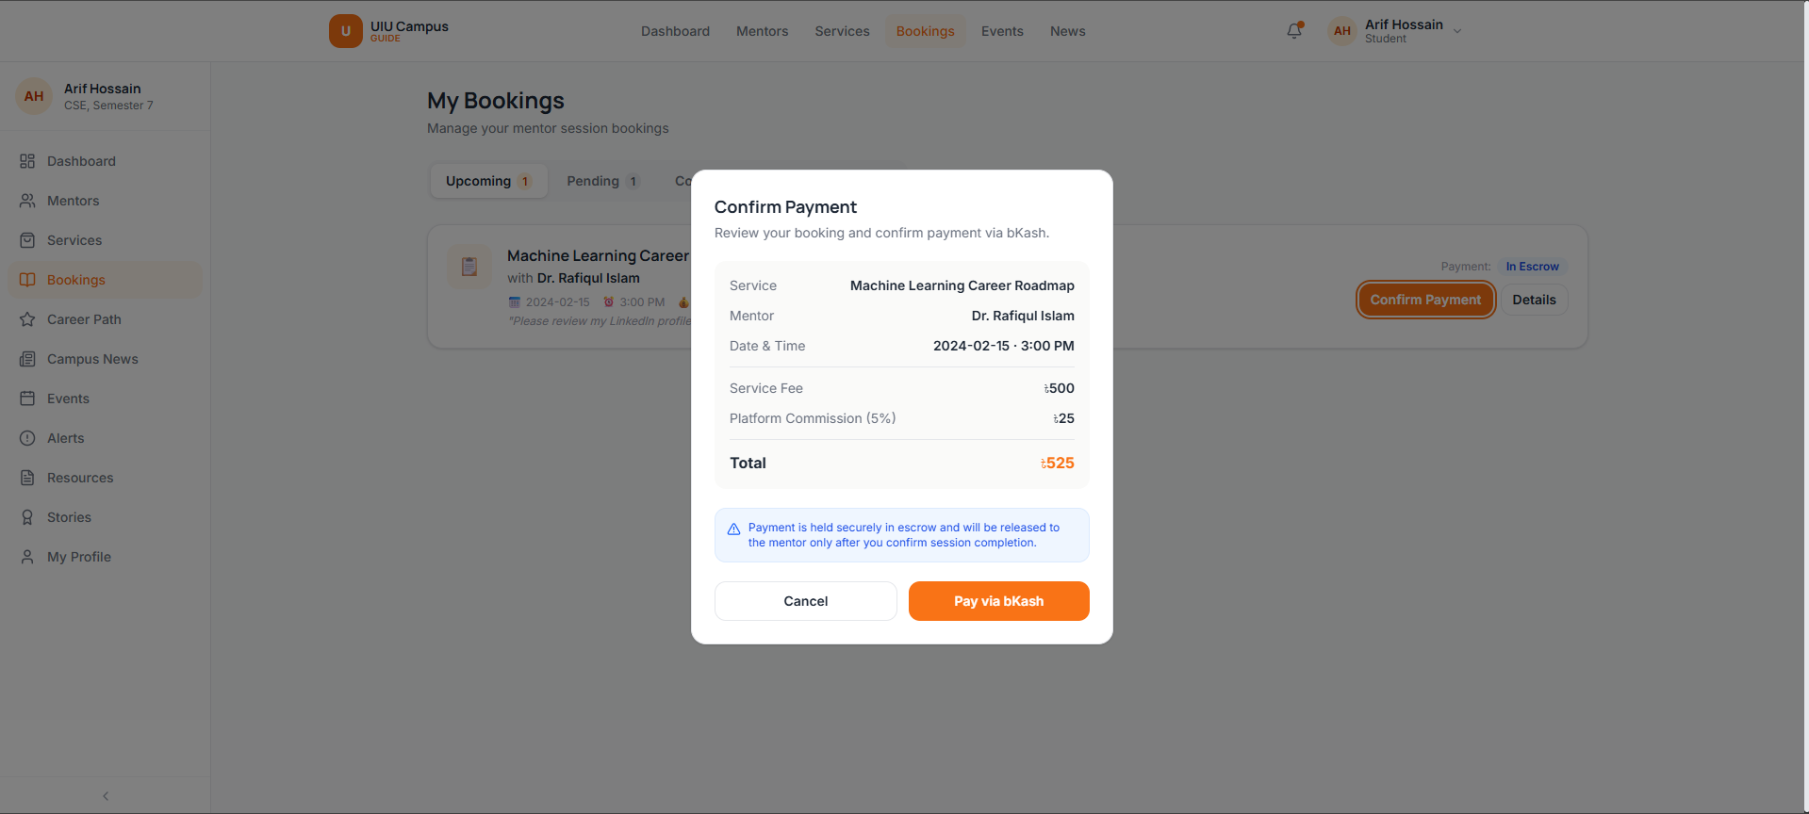
ESCROW PROTECTS EVERY PAYMENT
525 TAKA
500 service fee + 5% commission
Pay through bKash
1
Hold in escrow
2
Confirm the session
3
Then release to the mentor
Notes:
The example service fee is 500 taka. A 5% commission adds 25 taka, making the student's total 525. Payment is held in escrow. The mentor receives the release only after the student confirms the session.

Slide 7
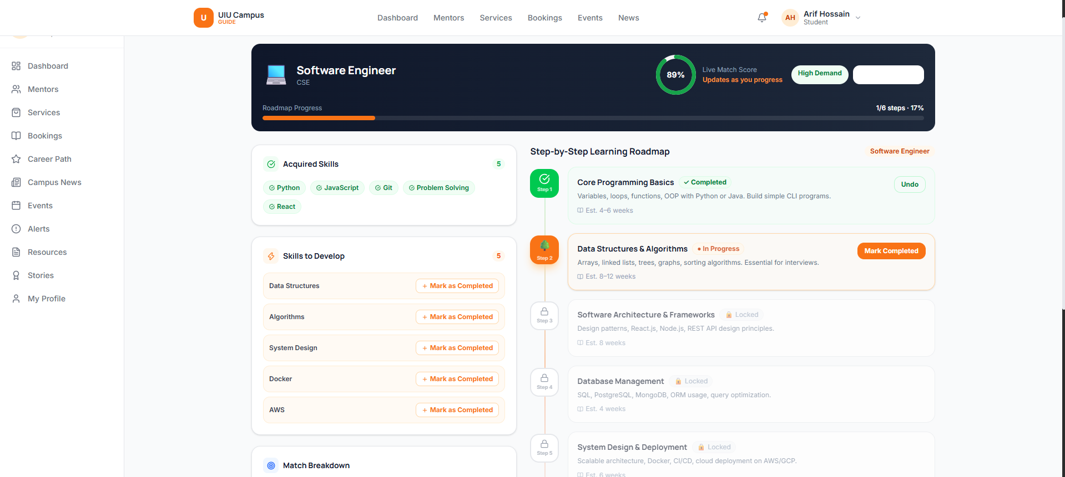
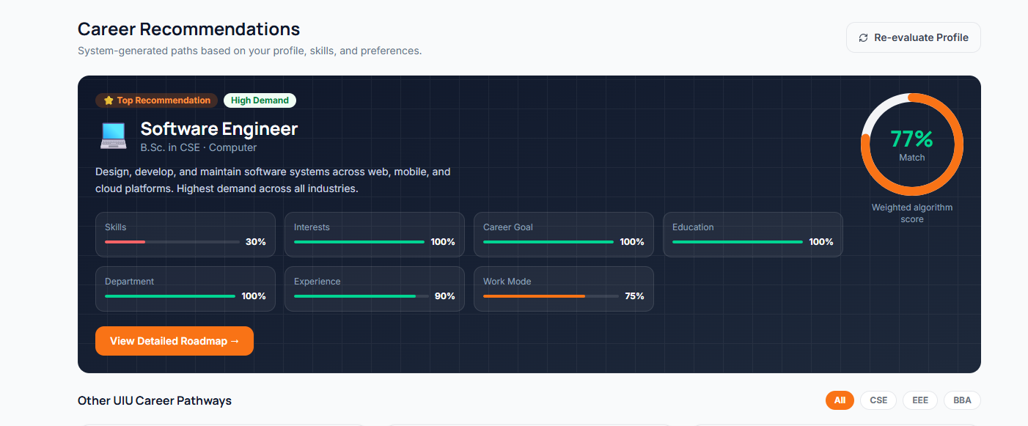
CAREER PATH TURNS A PROFILE INTO A ROADMAP
Three-step profile · Software Engineer · 77%
Six-step learning roadmap · tracked progress
Notes:
Career Path begins with a three-step profile and produces match scores. Software Engineer appears at 77% in this example. The student can then follow a six-step learning roadmap and track progress. The match score is guidance, not a guarantee of career success.

Slide 8
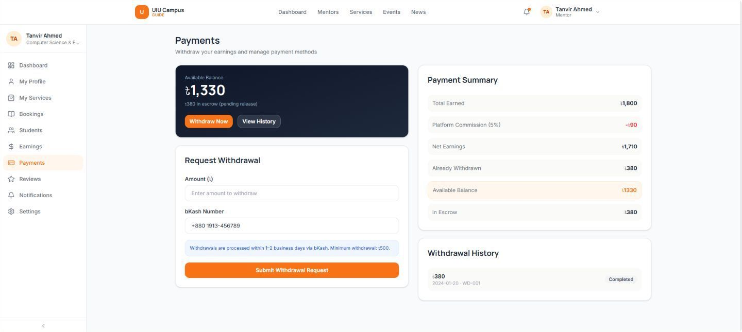
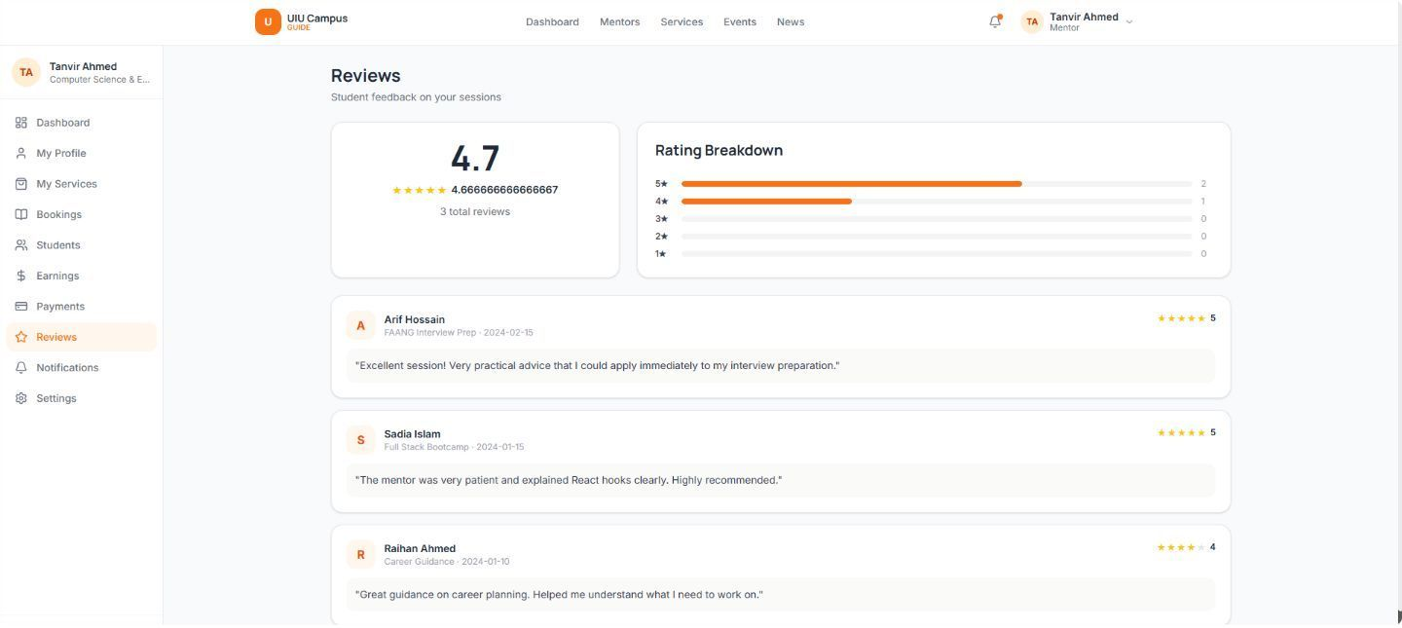
MENTORS EARN, REVIEWS BUILD TRUST
Manage earnings
See student feedback
Withdrawals through bKash
4.7 average across three reviews
Notes:
Mentors can manage withdrawals through bKash and review student feedback. The example shows an average rating of 4.7 across three reviews. Earnings support participation, while visible reviews help students judge a service before booking.

Slide 9
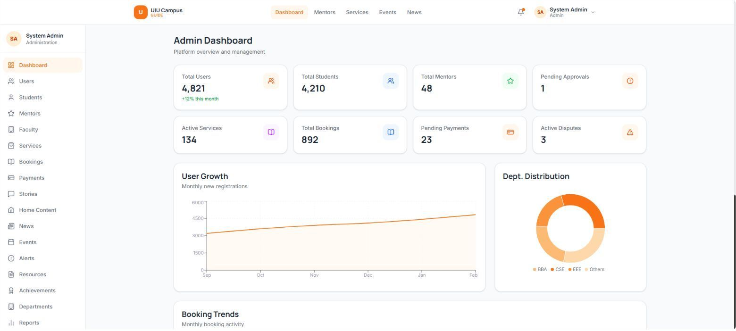
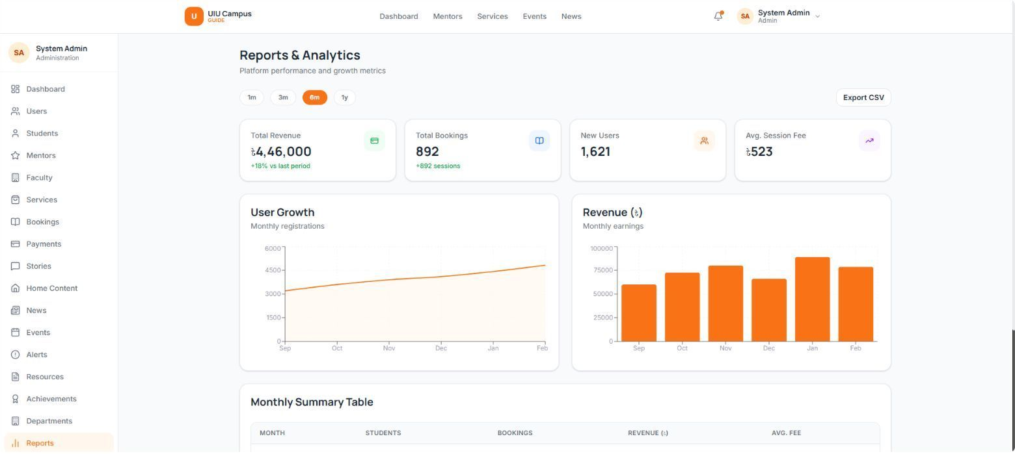

ADMINS SEE THE WHOLE PLATFORM
4,821 users
134 services
892 bookings
4,46,000 taka
Revenue · six months
Platform dashboard
Six-month revenue report
Notes:
The supplied admin dashboard shows 4,821 users, 134 services and 892 bookings. The report shows total revenue of 4,46,000 taka over six months. These are the values displayed in the product evidence, not an independently verified adoption study.

Slide 10
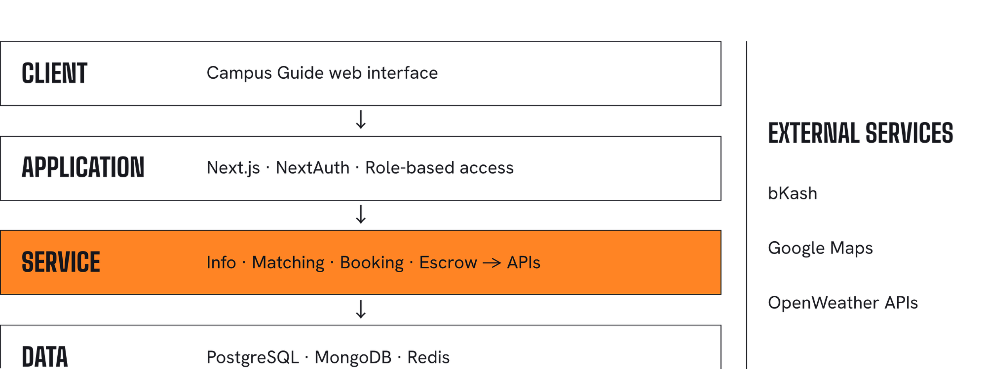
BUILT ON A MODERN, LAYERED ARCHITECTURE
One platform · Four layers · Shared integrations
Notes:
The client presents Campus Guide to its users. The application layer uses Next.js, NextAuth and role-based access. The service layer handles campus information, matching, booking and escrow, and connects to external APIs. PostgreSQL, MongoDB and Redis form the data layer. The integrations are bKash, Google Maps and OpenWeather.

Slide 11
MENTORS RUN THEIR OWN SERVICES
Booking requests
Earnings summary
New services
Pending requests: Accept or Reject
12,400 taka this month
Form submitted for admin approval
4.7 average rating
Mentor dashboard
Notes:
Mentors manage their work from one dashboard. They accept or reject pending booking requests, track this month’s 12,400 taka in earnings, and submit new services for admin approval. Their average rating is 4.7.

Slide 12
ADMINS MODERATE EVERY SERVICE AND BOOKING
4,46,000 taka
892 bookings
1,621 users
Revenue
Total
New
Users and services
Booking management
User management: 7 users
Roles: student, mentor, faculty, admin
Service approvals
Reports and analytics
Status: Confirmed, Pending, Completed
Payment: In Escrow, Pending, Released
Notes:
Admins manage seven users across four roles, approve services, and track bookings and payments. Reports show 4,46,000 taka revenue, 892 bookings and 1,621 new users.

Slide 13
TESTED AGAINST EVERY REQUIREMENT
64
15
0
Functional requirements
Test cases · 60+ in full suite
Uncovered M-priority requirements
Testing scope
Unit
Integration
System
Acceptance
Regression
Security
Performance
Accessibility
Notes:
The project has 64 functional requirements. We present 15 representative test cases from a suite of 60+, with no M-priority requirement left uncovered. Testing spans eight types, from unit to accessibility.

Slide 14
LIMITATIONS AND WHAT COMES NEXT
Limitations
What comes next
Single-campus UIU scope
Mentor marketplace cold-start
Depends on bKash, Vercel, MongoDB Atlas and API uptime
Content freshness depends on faculty publishing
Native apps, AI tutoring, other payment providers out of scope
Multi-campus expansion to other Bangladeshi universities
Alumni mentor network and employer partnerships
Pro Mentor verified badge
Institutional analytics dashboards
Bundled roadmap services: certifications, clubs, workshops
Notes:
Campus Guide is scoped to UIU and depends on mentor supply, faculty content and third-party uptime. Next steps are multi-campus growth, an alumni network, a Pro Mentor badge, analytics and bundled roadmap services.

Slide 15

THANK YOU
From a UIU student platform to a scalable campus ecosystem.
Team Syntax Squad
UIU Department of CSE
Faculty teacher Rejwan Ahmed
Notes:
Thank you. We are Team Syntex Squad from the UIU Department of CSE, and we welcome your questions.

